Slide 1
INTRODUCTION HTML & JAVASCRIPT

Slide 2
What is HTML?
HTML is the standard markup language for creating Web pages.
HTML stands for Hyper Text Markup Language
HTML describes the structure of Web pages using markup
HTML elements are the building blocks of HTML pages
HTML elements are represented by tags
HTML tags label pieces of content such as "heading", "paragraph", "table", and so on
Browsers do not display the HTML tags, but use them to render the content of the page

Slide 3
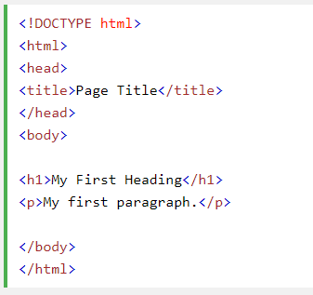
A Simple HTML Document
The <!DOCTYPE html>
declaration defines this document to be HTML5
The <html> element is the root element of an HTML page
The <head> element contains
meta information about the document
The <title> element specifies a title for the document
The <body> element contains the visible page content
The <h1> element defines a large heading
The <p> element defines a paragraph

Slide 4
HTML Tags
HTML tags are element names surrounded by angle brackets:
<tagname>content goes here...</tagname>
HTML tags normally come in pairs like <p> and </p>
The first tag in a pair is the start tag, the second tag is the end tag
The end tag is written like the start tag, but with a forward slash inserted before the tag name

Slide 5
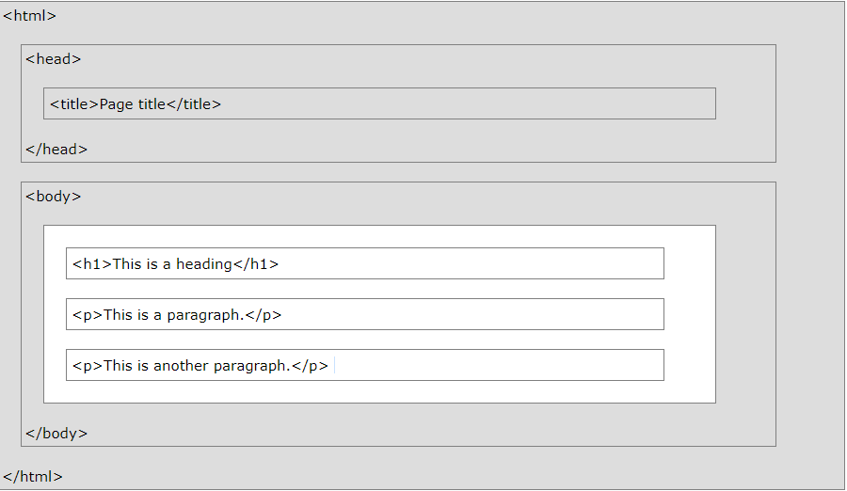
HTML Page Structure

Slide 6
REFERENCE
https://www.w3schools.com/html/default.asp
https://www.tutorialspoint.com/html_online_training/index.asp

Slide 7
What is JavaScript ?
Javascript is a dynamic computer programming language. It is lightweight and most commonly used as a part of web pages, whose implementations allow client-side script to interact with the user and make dynamic pages. It is an interpreted programming language with object-oriented capabilities.
JavaScript was first known as LiveScript, but Netscape changed its name to JavaScript, possibly because of the excitement being generated by Java. JavaScript made its first appearance in Netscape 2.0 in 1995 with the name LiveScript. The general-purpose core of the language has been embedded in Netscape, Internet Explorer, and other web browsers.

Slide 8
Advantages of JavaScript
Less server interaction − You can validate user input before sending the page off to the server. This saves server traffic, which means less load on your server.
Immediate feedback to the visitors − They don't have to wait for a page reload to see if they have forgotten to enter something.
Increased interactivity − You can create interfaces that react when the user hovers over them with a mouse or activates them via the keyboard.
Richer interfaces − You can use JavaScript to include such items as drag-and-drop components and sliders to give a Rich Interface to your site visitors.

Slide 9
Limitations of JavaScript
Client-side JavaScript does not allow the reading or writing of files. This has been kept for security reason.
JavaScript cannot be used for networking applications because there is no such support available.
JavaScript doesn't have any multithreading or multiprocessor capabilities.

Slide 10

JavaScript Syntax
JavaScript can be implemented using JavaScript statements that are placed within the <script>... </script>.
You can place the <script> tags, containing your JavaScript, anywhere within your web page, but it is normally recommended that you should keep it within the <head> tags.

Slide 11
REFERENCE
https://www.w3schools.com/js/js_htmldom_elements.asp
https://www.tutorialspoint.com/javascript/javascript_syntax.htm

